Slide 1
Deleting a node in Fibonacci Heap and its cost involved

Slide 2
Deleting a node
FIB-HEAP-DELETE(H, x)
FIB-HEAP-DECREASE-KEY(H, x, -∞)
FIB-HEAP-EXTRACT-MIN(H)

Slide 3
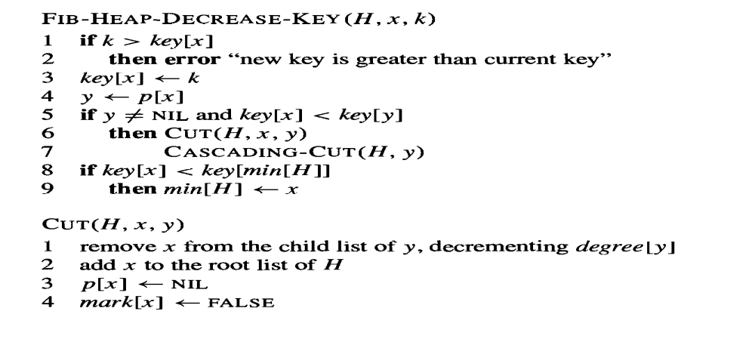
Delete Key

Slide 4
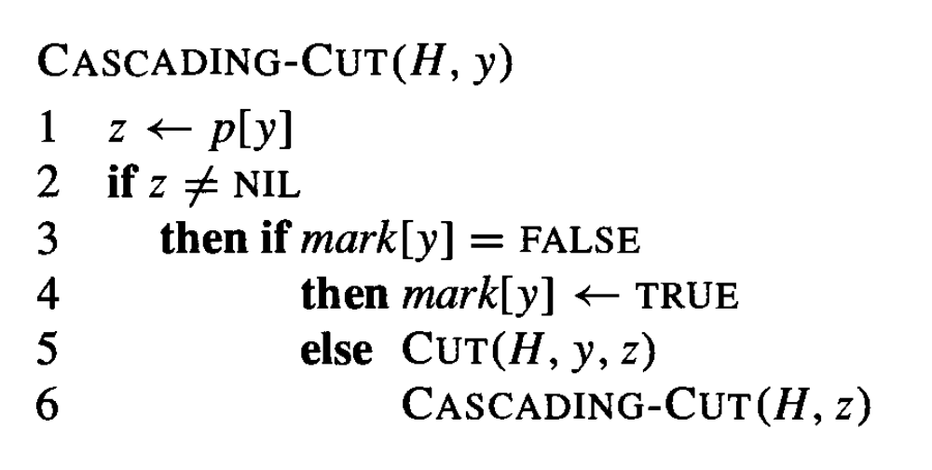
Delete key

Slide 5
